Slide 1
Entry | Photocat. Loading (mol%) | NiBr2 Loading (mol%) | DBU (Equiv.) | SM conc. (M) | Boc-HNHN₂ (Equiv.) | Temp. (°C) | SMª |  | Aª (%) | Bª (%) | Cª (%)
N1 | 0.1 | 2.5 | 1.5 | 0.2 | 2 | 80 | 89 |  | 8 | 2 | 1
N2 | 0.5 | 2.5 | 1.5 | 0.2 | 4 | 80 | 79 |  | 16 | 1 | 3
N3 | 0.1 | 7.5 | 1.5 | 0.2 | 4 | 120 | 70 |  | 22 | 1 | 7
N4 | 0.5 | 7.5 | 1.5 | 0.2 | 2 | 120 | 32 |  | 56 | 2 | 9
N5 | 0.1 | 2.5 | 3 | 0.2 | 4 | 120 | 76 |  | 18 | 1 | 5
N6 | 0.5 | 2.5 | 3 | 0.2 | 2 | 120 | 45 |  | 37 | 8 | 10
N7 | 0.1 | 7.5 | 3 | 0.2 | 2 | 80 | 91 |  | 6 | 1 | 2
N8 | 0.5 | 7.5 | 3 | 0.2 | 4 | 80 | 76 |  | 20 | 1 | 3
N9 | 0.1 | 2.5 | 1.5 | 0.4 | 2 | 120 | 79 |  | 16 | 1 | 4
N10 | 0.5 | 2.5 | 1.5 | 0.4 | 4 | 120 | 65 |  | 27 | 1 | 7
N11 | 0.1 | 7.5 | 1.5 | 0.4 | 4 | 80 | 92 |  | 6 | 0 | 1
N12 | 0.5 | 7.5 | 1.5 | 0.4 | 2 | 80 | 83 |  | 14 | 1 | 2
N13 | 0.1 | 2.5 | 3 | 0.4 | 4 | 80 | 92 |  | 6 | 0 | 2
N14 | 0.5 | 2.5 | 3 | 0.4 | 2 | 80 | 83 |  | 11 | 2 | 4
N15 | 0.1 | 7.5 | 3 | 0.4 | 2 | 120 | 81 |  | 12 | 0 | 6
N16 | 0.5 | 7.5 | 3 | 0.4 | 4 | 120 | 64 |  | 25 | 1 | 9
N17 | 0.3 | 5 | 2.25 | 0.3 | 3 | 100 | 72 |  | 22 | 1 | 5
N18 | 0.3 | 5 | 2.25 | 0.3 | 3 | 100 | 74 |  | 21 | 1 | 4
N19 | 0.3 | 5 | 2.25 | 0.3 | 3 | 100 | 75 |  | 20 | 1 | 4

Slide 2

Photochemical Buchwald-Hartwig Amination with Hydrazine 7/05/2020
Alejandro Mata Gomez
Center for Continuous Flow Synthesis and Processing (CCFLOW), RCPE GmbH and
Institute of Chemistry, University of Graz, Austria
Alejandro.mata-gomez@rcpe.at http://goflow.at

Slide 3
DoE: Study of Fixed and Variable Conditions
Variable Conditions
Catalyst loading: 2.5 to 7.5 mol%. Range in consonance with literature
Photocatalyst loading: 0.1-0.5 mol%. Same as catalyst loading
Starting material concentration: 0.2 -0.4 M. We observed some solubility problems with Ni when exceeding 0.4 M
Temperature: 80 to 120 °C. We observed some inconclusive results at high temperatures
DBU: 1.5-3 equiv. This range answer the minimum needs for the reaction to work and the maximum equivalents to not been considered wasteful.
Boc hydrazine 2-4 equiv. same as DBU
Fixed Conditions
Residence time: 20 minutes as no improvement in yield was observed in the experiments checking the temperature.
Wavelength was set at 395 nm.

Slide 4
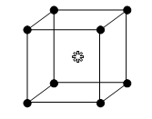
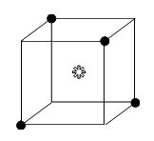
DoE Conditions
Discrete Variables
DoE Type
Base | Catalyst | Photocatalyst | Hydrazine derivative
DBU | NiBr₂·3H₂O | [Ir(dtbbpy)(ppy)₂]PF₆ | Boc hydrazine
Fixed Conditions
Residence Time | Wavelength
20 minutes | 395 nm
Fractional factorial of 16 experiments reduced from the full factorial of 64 experiments
Continuous Variables (factors)
 | SM conc. (M) | cat. loading (Mol %) | Photocat loading (Mol %) | Base (Equiv.) | Hydrazine (Equiv.) | Temperature (°C)
Range | 0.2 – 0.4 | 2.5 – 7.5 | 0.1 – 0.5 | 1.5 – 3 | 2 – 4 | 80 – 120

Slide 5
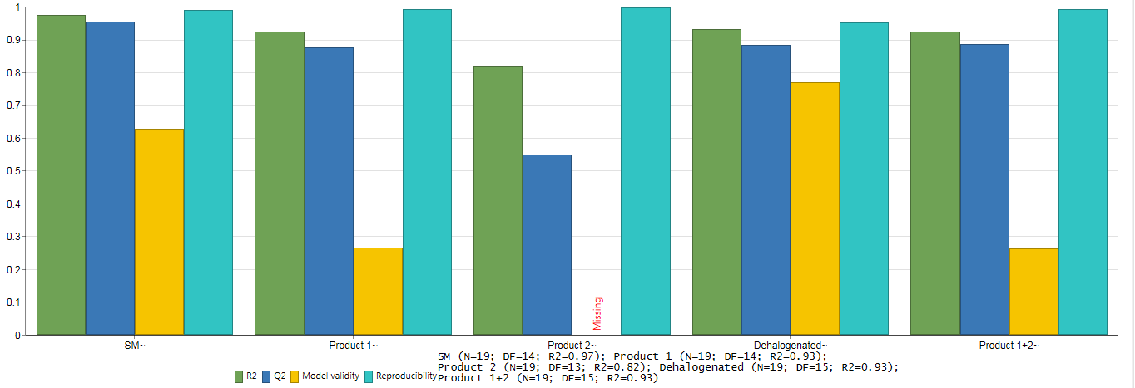
Second DoE Results
Model Statistics

Slide 6
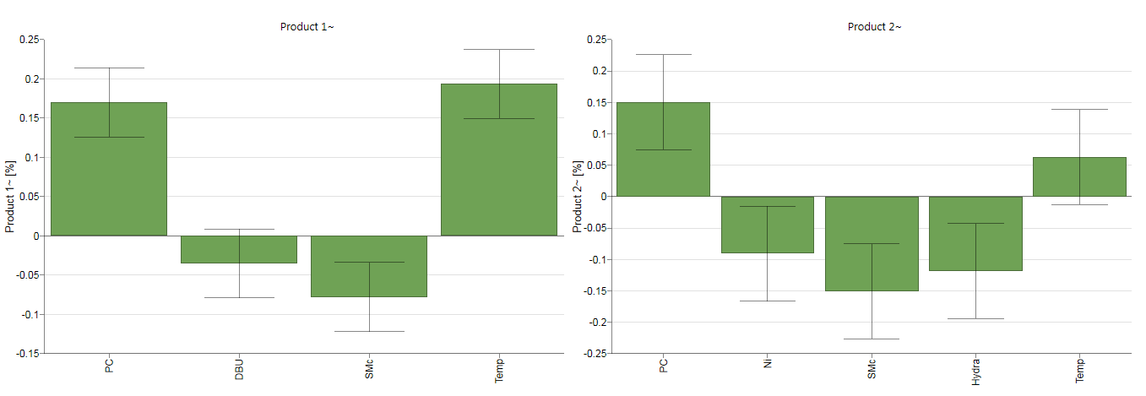
Second DoE Results
Coefficients for Desired Products

Slide 7
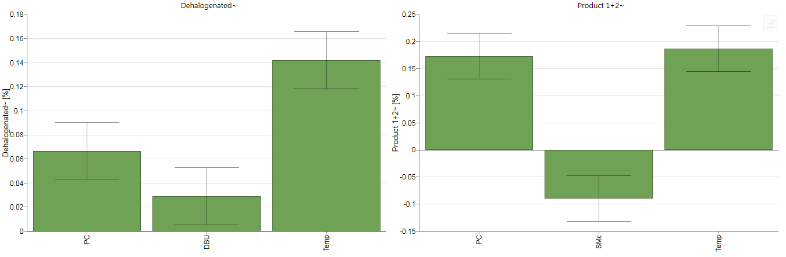
Second DoE Results
Coefficients for Sideproduct vs Products

Slide 8
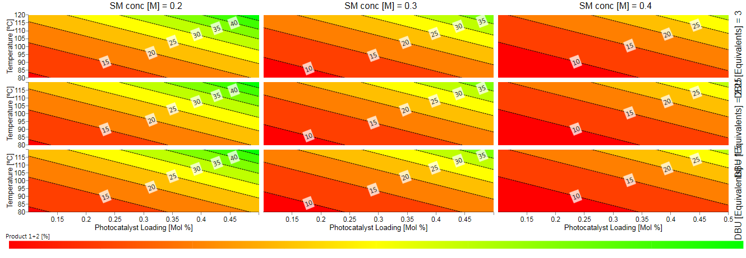
Second DoE Results
4D Contour

